Slide 1
Virtual Reality and Algebraic Visualizations
Sandy Avila, Amy Giroux, Jay Havekost, and Cortnee Stainrod
Team: The VR Mathronauts
IDS 6916: Research Practicum
Alpha Review Presentation
October 14, 2020

Slide 2
Background & Purpose of Study
Background:
Using VR technology to improve secondary school aged student’s algebraic formula manipulation understanding
Purpose of our Study:
To supplement existing curriculum for manipulating algebraic expressions (by way of using VR technology) to better understand the concept as well as practical application. This will increase accessibility for mathematics to help with learner performance and transfer of knowledge. Algebra was chosen as it is such a major base that much of the rest of mathematics is built upon.
This project makes the following contributions: * Increase ease of learning * Increase mathematics literacy * Decrease frustration with math * Increase accessibility to STEM careers for underrepresented groups

Slide 3
Problem Statement
Problem Statement:
Foundational mathematics skills are critical for learners of all ages. Students in primary and secondary school may miss out on important Algebraic foundations, such as equation manipulation, which impedes their confidence and ability to prepare for careers in STEM. Schools need novel tools to help struggling students reach proficiency in base algebraic skills which will open the door for opportunities for many marginalized learners.
Sweller, J. (1989). Cognitive technology: Some procedures for facilitating learning and problem solving in mathematics and science. Journal of educational psychology, 81(4), 457.

Slide 4
Justification: Why Algebra?
Mathematics is based on cumulative knowledge
Foundational skills are extra important
Low proficiency is difficult to recover from
Math literacy impacts career choices
Affects already underrepresented groups
Impacts confidence and is a barrier for entry to STEM fields
Gaps in existing tools
Novel approaches have been created for Geometry, Calculus, some Linear Algebra etc.

Slide 5
Justification: Why VR?
Common Current Learning Tools
Worksheets
You do, We do, I do
Improved Learning Tools
MathLabs and Khan Academy
More feedback and guidance
Needs for New Learning Tools
Accessible, visual, and novel approach to catch and empower struggling students

Slide 6
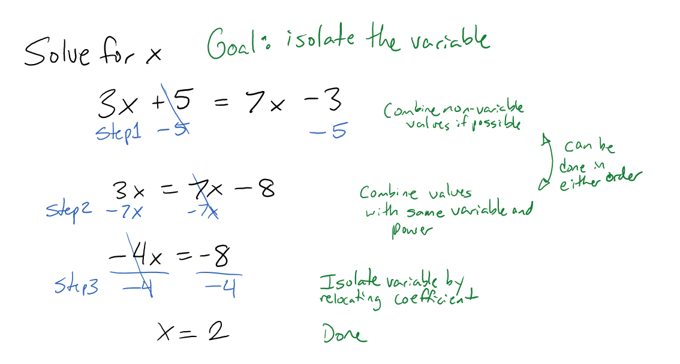
Example Problems: Algebraic formula manipulation
Easy
Addition, Subtraction, Multiplication, and Division
Variable only as a numerator
Medium
Addition, Subtraction, Multiplication, and Division
Variable includes fractions as coefficient.
Equation may require distribution
Hard
Addition, Subtraction, Multiplication, Division, and Roots.
Variable in the denominator
May be a formula that needs rearranging instead of an equation that can be solved
Example Easy Problem and Solution

Slide 7
How: Research Methods
Mixed Methods Approach- collecting both qualitative & quantitative data
Participants- secondary school math students
Materials / Apparatus - use of VR developed in Unity and utilizing Oculus Rift headset and hand controllers
Design- Mixed Design with Two level between-subjects factor
Procedure- running two sets of users through experiment
1 group handling math problems on paper
other running VR to work through math problems
Independent Variable: VR Technology
Dependent Variables:
1. Performance: Percent correct, and response time, time on task
2. NASA-TLX after each math scenario
TAM & Systems Usability Scale

Slide 8
How: Our Research Questions
Cognitive load: How does VR affect cognitive load between low, medium and high- level algebraic math skill tasks?
Performance/Perception: What is the difference in situational awareness (SA) measured by response time and accuracy based upon the algebraic math skill task in VR?
Complexity: How does VR affect how participants handle the difference between low- and high-level complexity of algebraic math skill tasks?
(For Future Considerations) Practical Application: How does VR help learners understand algebraic skills and their transfer between similar and distinct applications? (between classroom and practical applications)

Slide 9
How: Our Hypotheses
Cognitive Load: There will be a statistically significant difference in cognitive load, such that the VR condition will have lower NASA-TLX scores than the traditional paper format.
Performance: There will be a statistically significant difference as measured by performance (ie: response time and time on task) that under the VR condition due to ease of use, reduction of cognitive load, and improved spatial awareness.
Complexity: There will be a statistically significant difference between high and low complexity scores based on performance parameters under the VR condition.

Slide 10
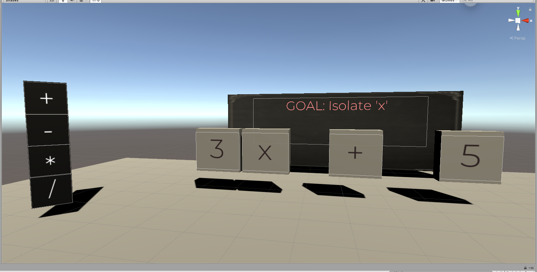
Storyboarding Prototype
Randomly generated problems based on High, Medium, Low difficulties.
Amount of time to solve problem is recorded to show delta in performance.
Assisted, non-assisted, test modes available to help get familiar with the system.

Slide 11
References/Resources
Kuo, H. C., Tseng, Y. C., & Yang, Y. T. C. (2019). Promoting college student’s learning motivation and creativity through a STEM interdisciplinary PBL human-computer interaction system design and development course. Thinking Skills and Creativity, 31, 1-10.
Ibáñez, M. B., & Delgado-Kloos, C. (2018). Augmented reality for STEM learning: A systematic review. Computers & Education, 123, 109-123.
Barrett, R., Gandhi, H. A., Naganathan, A., Daniels, D., Zhang, Y., Onwunaka, C., ... & White, A. D. (2018). Social and tactile mixed reality increases student engagement in undergraduate lab activities. Journal of Chemical Education, 95(10), 1755-1762.
Miller, D., & Dousay, T. (2015). Implementing augmented reality in the classroom. Issues and Trends in Educational Technology, 3(2).
Antonioli, M., Blake, C., & Sparks, K. (2014). Augmented reality applications in education. The Journal of Technology Studies, 96-107.
Lai, A. F., Chen, C. H., & Lee, G. Y. (2019). An augmented reality‐based learning approach to enhancing students’ science reading performances from the perspective of the cognitive load theory. British Journal of Educational Technology, 50(1), 232-247.
Burrows, A., Lockwood, M., Borowczak, M., Janak, E., & Barber, B. (2018). Integrated STEM: Focus on informal education and community collaboration through engineering. Education Sciences, 8(1), 4.
Jackson, C., Appelgate, M., Seiler, G., Sheth, M., & Nadolny, L. (2016). Using a Virtual Environment to Uncover Biases, Assumptions, and Beliefs and Implications for Mathematics Teaching. Conference Papers -- Psychology of Mathematics & Education of North America, 1333–1336.
Hwang, W. Y., & Hu, S. S. (2013). Analysis of peer learning behaviors using multiple representations in virtual reality and their impacts on geometry problem solving. Computers & Education, 62, 308-319.
Kaufmann, H., Schmalstieg, D., & Wagner, M. (2000). Construct3D: a virtual reality application for mathematics and geometry education. Education and information technologies, 5(4), 263-276.
Khan, M., Trujano, F., & Maes, P. (2018, June). Mathland: Constructionist Mathematical Learning in the Real World Using Immersive Mixed Reality. In International Conference on Immersive Learning (pp. 133-147). Springer, Cham.
Hall, C. R., Stiles, R. J., & Horwitz, C. D. (1998, March). Virtual reality for training: Evaluating knowledge retention. In Proceedings. IEEE 1998 Virtual Reality Annual International Symposium (Cat. No. 98CB36180) (pp. 184-189). IEEE.

Slide 12
Thank you....any questions?

